Slide 1

Assignment4 Game Programming
201811280 이승제

Slide 2
GamePlay
New feature: Double Jump
Included Features: move, jump, look, fire, random spawn wave, enemy random move

Slide 3
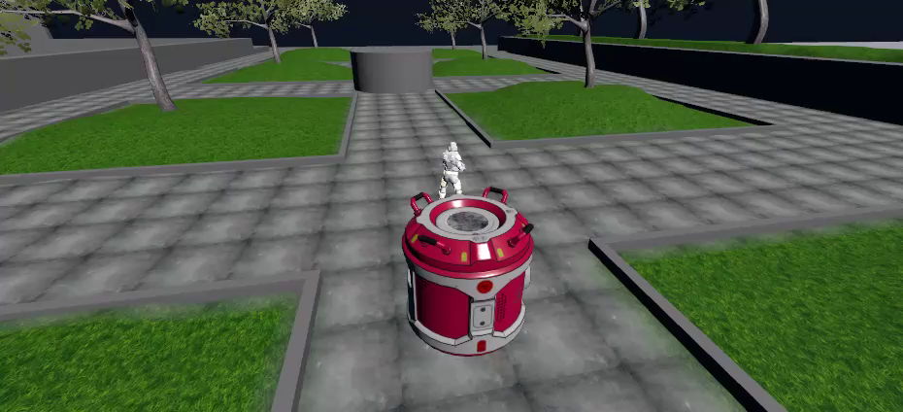
GamePlay

Slide 4
GamePlay
Lose Screen

Slide 5
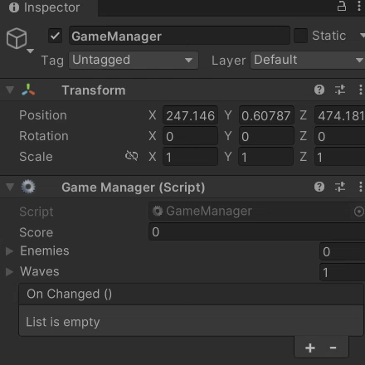
GamePlay
Game Manager

Slide 6
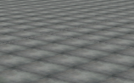

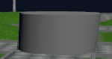

Physics Setup
1. static object: Terrain
2. kinematic object: Enemy
3. trigger static object: Base
4. trigger kinematic object: Bullet

Slide 7
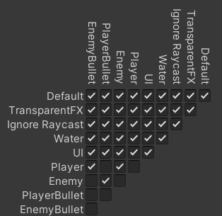
Physics Setup
Layer Collision Matrix

Slide 8
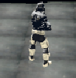
Objective
Win
Lose
Win and Lose Condition

Slide 9

Thank you

